Slide 1
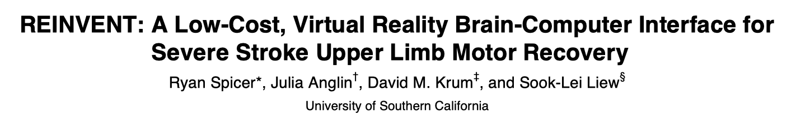
IEEE VR 2017

Slide 2
Introduction
Stroke is one of the leading causes of adult disability worldwide, and despite intensive physiotherapy, up to 2/3 of stroke survivors never fully recover. (severe motor impairments, unable to move their arm or hand)
Facilitate activation of the damaged motor cortex in the absence of volitional movement
Two primary ways include:
the action observation network (AON): active during both the performance of an action and simply during the observation of an action
neurofeedback from brain computer interfaces (BCIs): sensory feedback of biological activity in the brain; control a computerized device
Combine approaches and provide biologically-relevant action observation feedback in an immersive virtual reality BCI environment.
REINVENT pairs an individual’s own neural and muscular commands with augmented, but believable, embodied feedback of one’s own movements in virtual space.
Visual feedback of one’s own limb moving is an effective way to activate the AON and ‘close the loop’ between a motor command and sensory feedback.
Here we report the technical specifications of REINVENT as well as preliminary feasibility and safety testing with healthy older adults.
REINVENT
(Rehabilitation Environment using the Integration of Neuromuscular-based Virtual Enhancements for Neural Training)

Slide 3
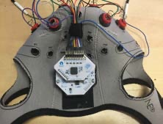
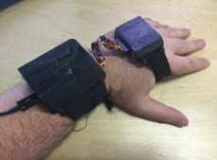
System Description
REINVENT provides flexible options to use just EEG, just EMG, or a combination of both to drive the neurofeedback, and employs a low-cost system with 3D printed components and a laptop to keep the unit affordable and portable.
REINVENT is an integrated hardware-software BCI system that receives data from brain/muscle sensors, integrates and analyzes the data in near real-time, and generates virtual reality feedback for a participant and on-screen status information for a clinician.

Slide 4
System Description
Hardware
OpenBCI(16) EEG(12)/EMG(4) device(125Hz), a wearable forearm motion capture system including two Nine Degrees of Freedom (9DOF) interial measurement units (IMUs, 120Hz), a computer, and a Head-Mounted Display (HMD, Oculus DK2).
Data Integration and Processing
REINVENT Peripheral Interface: Data received from the OpenBCI and IMU systems are processed via a .NET 4.5 application, which connects to the peripherals via USB Serial, and hosts a TCP/IP server.
REINVENT VR application: a VR display including a virtual arm and simple room scene including a desk surface, similar to the physical setting of the experiment.
Feasibility and safety with older adults
12 individuals for this 1-hour experiment (11 female/1 male, aged: M=83±10.5)
Eligibility criteria included healthy individuals with no previous experience with virtual reality.Informed consent was obtained from all subjects, and the experimental protocol was approved by the Institutional Review Board at USC and performed in accordance with the 1964 Declaration of Helsinki.
Participants were asked to rest for a 30second baseline calculation of EEG and EMG signals. Participants were then asked to try to control their virtual arm in REINVENT and move it towards goal positions using either actual arm movements (IMUs), just muscle activity (EMG), or just brain activity (EEG; using motor imagery), for up to thirty trials of each.
Simulator Sickness Questionnaire(total m:1.16±0.29)/interesting (m:9.67±0.62)/enjoyable (m:8.92±1.19)

Slide 5
Conclusion and future work
We have described a novel low-cost, portable VR-based brain computer interface and demonstrated the feasibility and safety of using this device with older adults.
Feedback from these individuals was used to further refine the REINVENT interface.
Future research will examine the feasibility and preliminary effectiveness of using REINVENT with older adults after stroke.

